Slide 1
Introduction to T2G Ethernet MAC
Merwin Ebenezer (ATV MC TM PEW1)
12th September 2024

Slide 2
Introduction
So far, we have seen
Frame format
Auto Negotiation, MDI/MDI-X, MDIO
MII Interfaces
Generic MAC structure
Memory
DMA/FIFO
MAC
PHY
Connectors
MAC
MII/MDIO
MDI

Slide 3
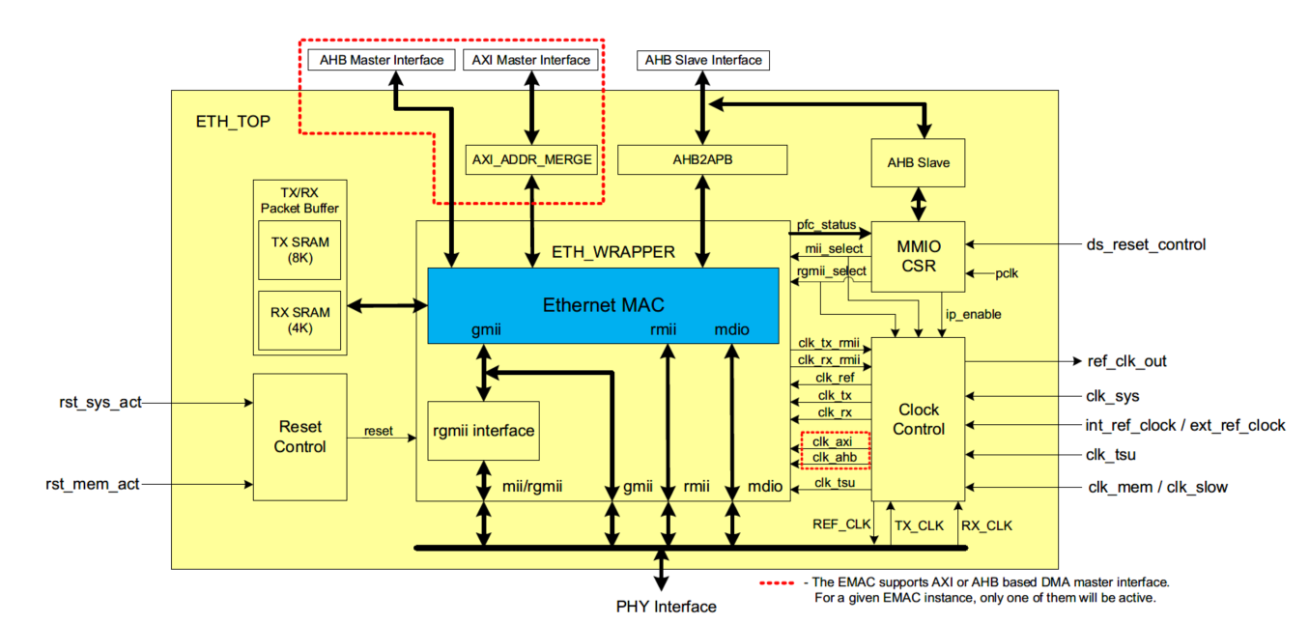
TRAVEO-II Ethernet MAC - Overview
T2G MAC supports 10/100/1000Mbps speeds at Full duplex in MII/RMII/GMII and RGMII interface modes
Supports Half-Duplex only in RMII Mode
Has AXI/AHB Master Interface for DMA (EMAC has a dedicated internal DMA)
AHB Slave interface for Configuration.
Internal 8KB TX RAM and 4KB RX RAM for packet buffering inside the MAC

Slide 4
MAC features and standard compliance
Full Store & Forward and Partial Store Forward
RMII version 1.2 from RMII consortium
RGMII OPEN Alliance specified RGMII v2.2 basically on top of RGMII specification v1.3
Single dedicated DMA with Tx/Rx Engines with three TX/RX Queues
IEEE 802.1Qav – Credit based shaping of Transmit Queues
IEEE 802.1AS – gPTP for deterministic traffic
IEEE 1588 – PTP for Time Synchronization
Flow Control
IEEE 802.3x – PAUSE Frames in Full Duplex operation
IEEE 802.1Qbb – Priority based Flow control in Full duplex operation
Half-duplex flow control using back-pressure (via SW) – only in RMII mode.
Checksum offload for TCP/IP/UDP in both TX/RX sides.
CRC and Pad insertion on Transmit frames
IEEE 802.3az for Energy Efficient Ethernet.

Slide 5
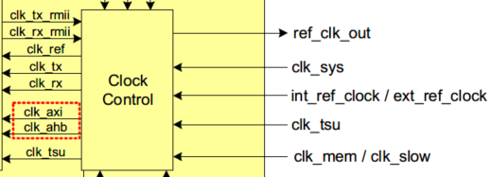
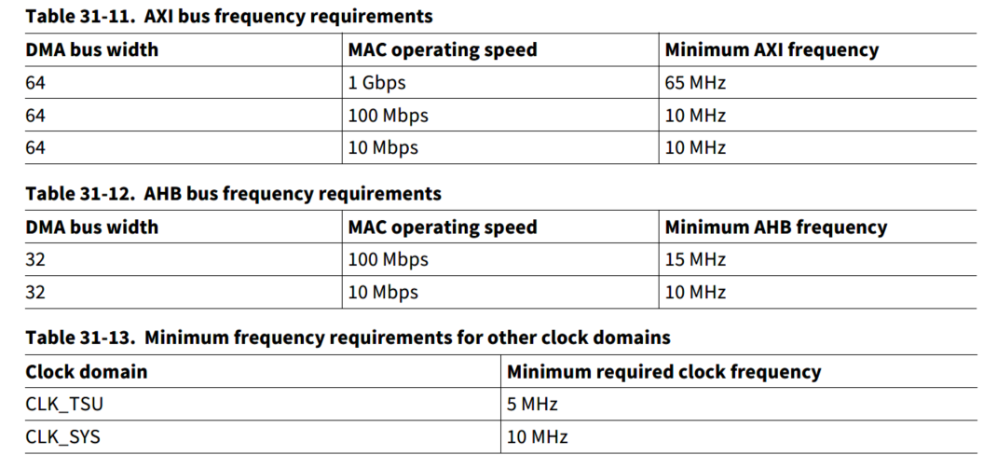
Clocks to EMAC – in detail
Clocks in EMAC
clk_sys CLK_HF0->CLK_PERI->CLK_GR4 (for MDC and CSR registers)
clk_mem CLK_HF0->CLK_MEM – AXI Operations (clk_axi)
clk_slow CLK_HF0->CLK_MEM->CLK_SLOW – AHB Operations (clk_ahb)
clk_tsu CLK_HF5 - For TSU (Timestamp unit)
pclk MDC clock after clock division, pclk is derived from clk_sys
int_ref_clk CLK_HF4 - Internal Reference Clock (for RMII/GMII/RGMII)
Note:
1. Not all ETH instances/interfaces support internal clock modes.
2. Confirm the clock path from device specific datasheet

Slide 6
DMA and Descriptors
Ethernet get the data from memory through DMA and stores them in local MAC Packet buffer
DMA uses Descriptors to fetch the Ethernet packet data
Descriptors help in making Ethernet packet buffers scattered around the Memory
Descriptors are created in memory and updated with necessary details before handing it over to DMA.
TX/RX descriptors can be 2 or 4 words (depending on whether we use normal/extended mode)
Descriptors for DMA consists of the following information
Address of the buffer in memory
Transmit/Receive status
Timestamp information (if enabled)
* Refer the ATRM for the specific details for each
TX/RX Descriptor lists
TX/RX Buffers in Memory
Descriptor 1
*ptr
Buffer 1
Descriptor 2
Buffer 2
*ptr
Descriptor 3
Buffer 3
Descriptor 4
Buffer 4
TX/RX DMA
MAC Packet buffer
MAC Transmitter/Receiver

Slide 7
SW Initialization sequence
This gives the basic flow inside the EMAC for TX/RX
Considering the GPIO are initialized and the MDIO for the PHY is taken care as well.
ETHx_CTL register
Set the Interface mode (MII/RMII/GMII or RGMII)
Select the REFCLK_SRC_SEL (if needed) and the REFCLK_DIV
Enable the IP
ETHx_network_config register
Speed, Duplex, MDC Clock division (current driver in SDL is not flexible in this method)
ETHx_dma_config register - DMA Configuration
ETHx_transmit_q[0:2]_ptr register – Set the Tx Descriptor list address
ETHx_receive_q[0:2]_ptr register – Set the Rx Descriptor list address
ETHx_int_(q[1:2])_enable register – Interrupt enable for queue
ETHx_network_control register - Enable and start transmit/receive

Slide 8
Boards/Kits and Tools for testing
Boards/Kits:
CYTVII-B-H-8M-320-CPU
MII/RMII – Automotive Ethernet (TJA1100/TJA1101)
MII/GMII/RGMII – Industrial Ethernet (DP83867)
KIT_T2G-B-H_LITE
RMII - Industrial Ethernet (DP83825)
IDE and Drivers:
IAR Embedded Workbench with SDL
Modus ToolBox (only Lite kit is supported)
Tools:
Wireshark – for packet sniffing (wireshark)
Scapy – Python library for packet manipulation and testing (scapy)
Automotive Ethernet – Vector CANOe or any Media convertor (like RDDRONE-T1ADAPT)

